Slide 1
Operating Systems and Architectures CSCM98, Part 3: Concurrency and Thread/Process Synchronization
Dr. Benjamin Mora
1
Swansea University
Benjamin Mora
Notes:
Possibly Describe Transactional memory further

Slide 2
Content
What’s the point?
Synchronizing resources
Processes
Data (database)
Memory allocation
Synchronizing parallel algorithms
Shared Memory Based
Lamport, Petersen, Dekker’s algorithm. Busy waiting
Compare-and-Exchange.
Atomic Instructions.
Ring buffers.
Transactional memory.
Inter-Process Communications (IPCs) will be seen later.
2
Swansea University
Benjamin Mora
Notes:
Add ring buffers!

Slide 3
Coordination of Asynchronous Concurrent processes
3
Swansea University
Benjamin Mora

Slide 4
CPU and Code execution (déjà vu)
i=i+1;
Mov R1, i
Add R1, #1
Mov i, R1
ALU
PC
Stack Pointer and Program Counter
SP
i
3
4
R1
3
4
Registers
R2
Memory
CPU
Swansea University
Benjamin Mora
4

Slide 5
CPU and Code execution (déjà vu)
The execution of a program is always sequential.
=> Only one execution at a time (single processor).
Current Operating systems are multi-tasked. How is it possible to execute two different codes simultaneously ?
Real-Time code interleaving in real-time is obviously not possible.
One strength of the OS is its ability to quickly switch between different programs.
Task 1
Task 1
Task 2
…
t
5
Swansea University
Benjamin Mora

Slide 6
Coordination of Asynchronous Concurrent processes
Simple example: two threads incrementing a global variable i initialized to 0.
Thread 0
Thread 1
i=i+1;
i=i+1;
6
Swansea University
Benjamin Mora

Slide 7
Coordination of Asynchronous Concurrent processes
i should hopefully be incremented by 2 after the execution of the two threads.
The code is however faulty without some form of synchronization:
Thread 0
Thread 1
i
X 1
0
Mov R1, i
R1=0
Mov R1, i
R1=0
Add R1, #1
R1=1
Add R1, #1
R1=1
Mov i, R1
Mov i, R1
7
Swansea University
Benjamin Mora

Slide 8
Coordination of Asynchronous Concurrent processes
The increment of the global variable i should have been atomic (one process at a time).
Such a section of code that can only be accessed/computed by one process is called a critical section.
The variable i can be seen as a resource that must be accessed in mutual exclusion by the 2 processes.
8
Swansea University
Benjamin Mora

Slide 9
Coordination of Asynchronous Concurrent processes
If this code is located inside a properly implemented critical section, the final result is ensured to be 2, whatever the processing order is.
If a results depends upon the processing order, then the situation is called a race condition.
Example: two travel agencies booking at the same time the last seat available on a given flight.
Critical Sections are often used to deal with resources.
E.g., Printer driver code.
9
Swansea University
Benjamin Mora

Slide 10
Coordination of Asynchronous Concurrent processes
4 requirements for mutual exclusion.
Mutual exclusion No two or more processes may be running the critical section.
Progress A process that is waiting for entering a critical section must be allowed to do so in a finite time if the critical section is not used by another process.
No external influence A process outside of the critical section must not influence the decision as to which process will enter the critical section next.
Bounded waiting There must be a limit on how many times a process can enter a critical section while another process is waiting.
10
Swansea University
Benjamin Mora

Slide 11
Coordination of Asynchronous Concurrent processes
There are several mechanisms needed to ensure mutual exclusion.
Disabling Pre-emption (cf. scheduling).
Software-based solutions (based on shared memory)
Dekker, Lamport, Szymanski and Peterson’s algorithms.
Hardware based solutions
Atomic instructions like compare and exchange.
Used to implement higher level programming concepts like mutexes and semaphores.
Other solutions that may not be based on shared memory.
11
Swansea University
Benjamin Mora

Slide 12
Coordination of Asynchronous Concurrent processes
E.g., Disabling pre-emption.
Cooperative multitasking (Windows 3.1) instead of pre-emptive multitasking (Windows 95).
Co-operative multitasking: Processes tell the OS when their task is completed
Process is releasing the processor.
A process cannot be interrupted.
Usually not a good thing.
OS reliability = Software/Process Reliability
12
Swansea University
Benjamin Mora

Slide 13
Mutual Exclusion Algorithms
13
Swansea University
Benjamin Mora

Slide 14
Coordination of Asynchronous Concurrent processes
Let’s try first a software solution based on shared variables between processes!
Why? Libraries do exist!
Well, someone has to implement them! ;-)
Correctness of concurrent algorithms is intricate, but once knowledge and a good programming methodology are acquired, you should be alright.
14
Swansea University
Benjamin Mora

Slide 15
Mutual Exclusion : Bad soft. solution #1
Single Lock Variable:
Incorrect…
Single processor system assumed
in this example.
15
Swansea University
Benjamin Mora

Slide 16
Mutual Exclusion : Bad soft. solution #1
Lock Variable:
Incorrect…
16
Swansea University
Benjamin Mora

Slide 17
Mutual Exclusion : Bad soft. solution #2
Process Variable:
Inefficient (starvation) if
the other process does
not enter the critical
section…
17
Swansea University
Benjamin Mora

Slide 18
Mutual Exclusion : Bad soft. solution #3
Two Variables:
Deadlock…
18
Swansea University
Benjamin Mora

Slide 19
Mutual Exclusion : Bad soft. solution #3
Two Variables:
Deadlock…
X True
X True
Interruption
19
Swansea University
Benjamin Mora

Slide 20
Coordination of Asynchronous Concurrent processes
So far we have 3 algorithms:
1 incorrect with the two processes accessing the critical section.
1 leading to starvation (1 process is blocked for a long and possibly infinite time).
1 resulting in a deadlock (two processes blocked and can never make progress)
20
Swansea University
Benjamin Mora

Slide 21
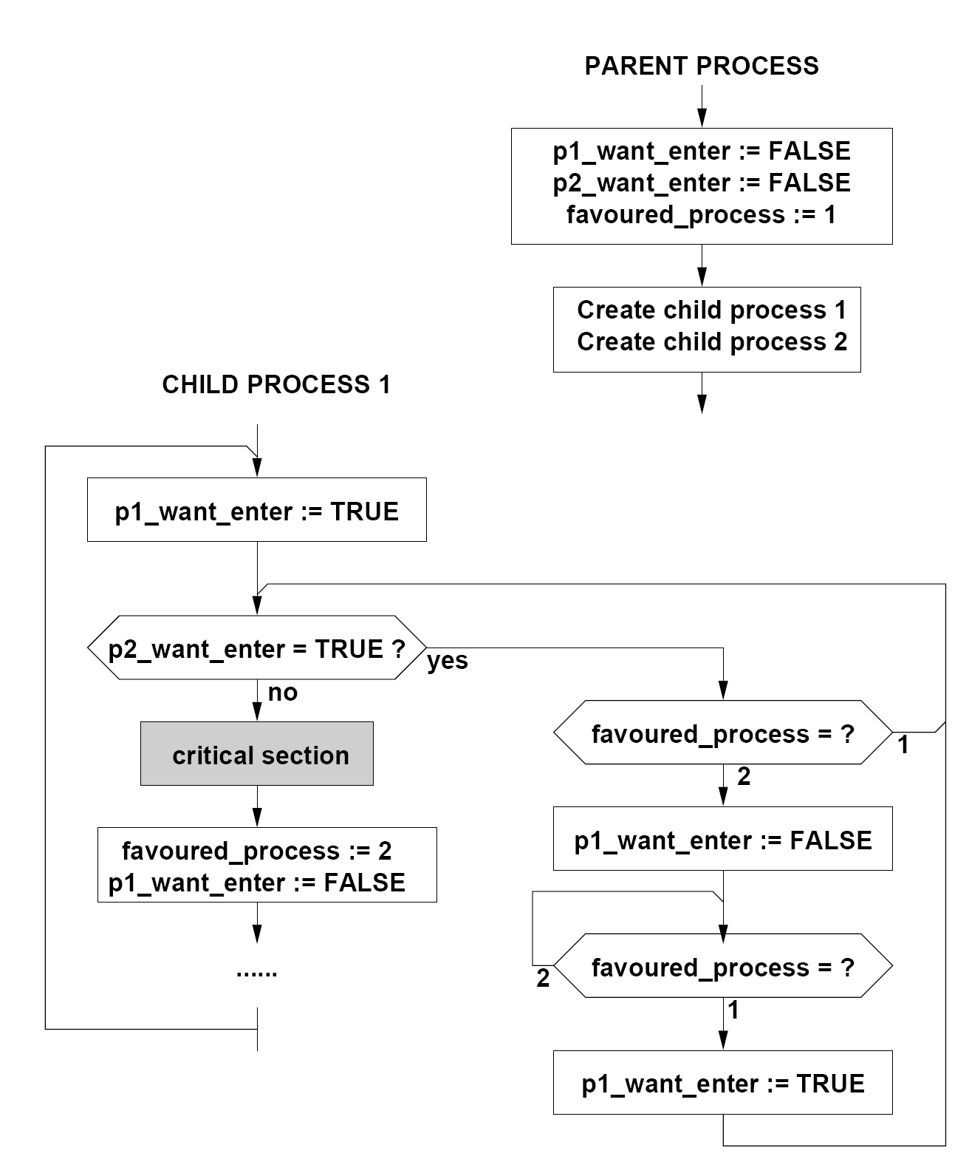
Mutual Exclusion : Dekker’s Algorithm
Correct this time…
Mutual exclusion guaranteed.
With atomic read/write
No Deadlock.
No Starvation.
21
Swansea University
Benjamin Mora

Slide 22
Shared Memory Mutual Exclusion
Dekker’s algorithm (1964) was the first solution that did not lead to infinite postponement or deadlock.
Lamport’s Bakery algorithm.
For n processes.
Peterson’s Algorithm (1981).
Simpler than Dekker’s.
Can be generalized to n processes (1990).
These algorithms are hard to design and even harder to be proven correct.
Not so good for Software maintenance.
Please just use available packages nowadays.
22
Swansea University
Benjamin Mora

Slide 23
Mutual Exclusion: Lamport’s algorithm
Thread(i) { //Source: Wikipedia http://en.wikipedia.org/wiki/Lamport's_bakery_algorithm
while (true) {
Enter[i] = 1;
Number[i] = 1 + max(Number[1], ..., Number[N]);
Enter[i] = 0;
for (j = 1; j <= N; j++) {
while (Enter[j] != 0) { // wait until thread j receives its number }
while ((Number[j] != 0) && ((Number[j], j) < (Number[i], i))) { }
// wait until threads with smaller numbers or with the same number, but with higher // priority, finish their work .
}
// critical section must be inserted here...
Number[i] = 0; // non-critical section...
}
}
with (a, b) < (c, d) equivalents to (a < c) or ((a == c) and (b < d))
23
Swansea University
Benjamin Mora

Slide 24
Mutual Exclusion: Lamport’s algorithm
Work for n concurrent processes.
Two n-dimensional arrays
One to tell the process wants to enter the critical section.
One to take a ticket!
Notice that process i only modifies i locations in arrays.
Educational algorithm more than anything else.
Purely software. Quite slow.
Only work on shared memory.
24
Swansea University
Benjamin Mora

Slide 25
Mutual Exclusion: Packages
Simpler mechanisms are usually available in different programming environments:
Compare and Exchange instruction (low level).
Atomic instructions (add, sub, e.g. )
Mutex.
Monitors.
Semaphores (Dijkstra’s).
The exact definitions of these different techniques sometime change according to the source…
25
Swansea University
Benjamin Mora

Slide 26
Mutual Exclusion: Compare & Exchange
LOCK CMPXCHG a,b Instruction (x86):
Compare eax register with a.
if a==eax then a=b;
else eax=a;
Available in hardware on most (x86) processors.
Atomicity is ensured by the processor (lock prefix).
Blocks other memory transfers.
Early hardware-accelerated solution.
Locks the memory bus: slows down memory transactions.
Similar instructions exist as well.
26
Swansea University
Benjamin Mora

Slide 27
Mutual Exclusion: Compare & Exchange
Let 1 represents a locked state, and 0 a non-locked state:
a will represent the lock state (Mutex).
b is 1, eax is initialized to 0.
if a==0 (not locked)
then a=1
//and eax is still 0
else eax=1 (locked)
//and a keeps its value=>1
27
Swansea University
Benjamin Mora

Slide 28
Mutual Exclusion: Compare & Exchange
Very fast, but:
Does not always prevent from starvation.
If one process has a higher priority, it may prevent the other from obtaining the lock.
Does not prevent from deadlock if misused (See later) with other locks. It must be used in an appropriate way as well! performance loss if a
while loop is used to wait for the lock (i.e. spinlock) …
System functions like pause are far more efficient…
Some higher-level mechanisms are provided in current programming environments to reduce/prevent these issues.
These mechanisms can implement Compare&Exchange.
28
Swansea University
Benjamin Mora

Slide 29
Mutual Exclusion: Mutex
A Mutex Class is available in numerous software libraries (e.g., C++11)
a Mutex m is declared as an object shared by the different threads and represents a lock on a resource.
When one wants to access the resource, a lock() method is called. lock() attempts to get the lock, and waits if it is not available.
The critical section can now be executed (the package ensures this).
unlock() must eventually be called.
If not done, deadlocks can occur!
29
Swansea University
Benjamin Mora

Slide 30
Mutual Exclusion: Mutex Example
std::mutex m; //c++11 mutex. Object must be shared across threads.
…
m.lock();
i=i+1; //critical section code run only by one process at a time
m.unlock();
30
Swansea University
Benjamin Mora

Slide 31
Mutual Exclusion: Atomic Add
Fetch data, add and copy to memory encoded within one single, non-interruptible instruction.
The instruction returns the previous increment value.
X86 fetch-and-add instruction.
LOCK and XADD combination.
OpenCL atomic instructions.
See example later on.
Can be used to implement mutexes.
31
Swansea University
Benjamin Mora

Slide 32
Mutual Exclusion: Dijkstra’s Semaphores
Allows the management of several resources available at the same time.
Based on three operations:
Init (Semaphore s, nbResources nb) {
s=nb;
}
P () { // also called DOWN or WAIT operation
wait until (s > 0), then
s = s - 1; // Must be atomic
}
V () {// also called UP or SIGNAL operation
s=s+1; //Must be atomic
}
Semaphores can cause deadlocks if P() and V() are not well-ordered!
32
Swansea University
Benjamin Mora

Slide 33
Mutual Exclusion: Monitors
Developed in the early 1970s by Per Brinch-Hansen and C. A. R. Hoare.
Similar to a Mutex.
Encapsulation is an important aspect of monitors.
Monitors appear in Java as synchronized methods and blocks (Though not as thorough as Hans&Hoare solution).
Can lock objects, portions of codes and objects.
wait(), notify(), and notifyall() functions can be placed inside synchronized code.
Compilers can help finding out possible issues with the code.
33
Swansea University
Benjamin Mora
Notes:
Discuss busy waiting. How monitors are an improvement over mutual exclusion (mutex)

Slide 34
Mutual Exclusion: Monitors
Definition: A monitor is essentially a shared class with explicit queues.
The queue is required to manage threads that are waiting for a signal.
This is invisible to the programmer.
Can still lead to detectable deadlocks if handled in the wrong way.
Java implementation of monitors is not as secure as the original one.
34
Swansea University
Benjamin Mora

Slide 35
High Performance Computing Oriented Concurrency techniques
35
Swansea University
Benjamin Mora

Slide 36
Reasons
While most concurrency problems can be seen as a resource access problem, it is not always the case.
Parallel (Scientific) Computing on many cores!
Needs to merge temporary results.
E.g., kNN and other iterative algorithms.
Fast concurrency algorithms are needed!
Barriers (CUDA, OpenCL, Posix threads, OpenMP, MPI)
atomic_add (OpenCL, CUDA, …)
Transactional memory (IBM & Intel’s Haswell procs.)
36
Swansea University
Benjamin Mora

Slide 37
Barriers
Seen with POSIX threads.
Principle: All threads must reach the barrier before being able to progress beyond the barrier.
Often used to compute separate temporary results before merging them.
37
Swansea University
Benjamin Mora

Slide 38
Barriers: Example Stream Compaction of Even Numbers
input
1
3
4
1
3
2
8
6
9
0
6
1
8
1
3
1
Output
4
2
8
6
0
6
8
?
?
?
?
?
?
?
?
?
Stream Compaction with a more complex classification criteria than even/odd often useful to HPC.
3-Step solution with barriers
Divide Array in N chunks attributed to N processes.
Cumulative sum of temporary results.
Move chunks around.
38
Swansea University
Benjamin Mora

Slide 39
Barriers: Example Stream Compaction of Even Numbers – 2 processes
Step 1: Separate work between processes
Process 0
Process 1
input
1
3
4
1
3
2
8
6
9
0
6
1
8
1
3
1
Output
4
2
8
6
?
?
?
?
0
6
8
?
?
?
?
?
39
Swansea University
Benjamin Mora

Slide 40
Barriers: Example Stream Compaction of Even Numbers – 2 processes
Step 2: Do a cumulative/prefix sum (not detailed). The result of this step should indicate that the first 3 items of Process 1 must be copied to indices starting from 4.
Process 0
Process 1
input
1
3
4
1
3
2
8
6
9
0
6
1
8
1
3
1
Output
4
2
8
6
?
?
?
?
0
6
8
?
?
?
?
?
40
Swansea University
Benjamin Mora

Slide 41
Barriers: Example Stream Compaction of Even Numbers – 2 processes
Step 3: Copy Items (could be done in parallel!)
Process 0
Process 1
input
4
2
8
6
?
?
?
?
0
6
8
?
?
?
?
?
Output
4
2
8
6
0
6
8
?
?
?
?
?
?
?
?
?
41
Swansea University
Benjamin Mora

Slide 42
Barriers
Threads
Step1(); //Classify
Barrier();
Step2(); //Cumulative Sum
Barrier();
Step3(); //Copy
Barrier(); //Possibly needed
Code
One or many threads can do this step
42
Swansea University
Benjamin Mora

Slide 43
Atomic Add (and etc.)
int atomic_add ( volatile __global int *p , int val)
OpenCL specifications
Add val to a value pointed by p, and return the previous value before increment.
C++11 version easier to implement.
Atomic operations good at reserving (different from allocating!) space inside an array, or reserving a range of computations
Atomic op. are still expensive as bus collisions may happen.
Need to be done at a coarser granularity than 1.
See pseudo-code for stream compaction with Atomic Add.
Granularity of 1.
43
Swansea University
Benjamin Mora

Slide 44
Atomic Add (and etc.)
void threadNJob (int *input, int *output, int first, int last,
volatile __global int *reservationCounter) {
for (int i=first;i<last;i++)
if ((input[i]&1)==0)
{
int pos= atomic_add(reservationCounter,1);
Output[pos]=input[i];
}
} //code not tested!!!
44
Swansea University
Benjamin Mora

Slide 45
Transactional Memory
TM Proposed by IBM.
Blue Gene/Q hardware
Database applications.
Implemented by Intel on their Haswell Chips!
2 versions: 1 compatible with previous hardware!
First Version bugged: Disabled through microprocessor update!
Hardware instructions to delimit critical sections of code.
Like a mutex lock/unlock mechanism.
E.g., XACQUIRE/XRELEASE instructions.
Locking and unlocking mutex mechanisms require many clock cycles and inefficient access to global memory.
Information needs to travel from cache to cache.
45
Swansea University
Benjamin Mora

Slide 46
Transactional Memory
It is often highly probable that several threads can enter a critical section as they are modifying distinct regions of memory!
E.g., tables in a database.
Sometime the region is the same, hence the need for a locking mechanism put in place.
A single lock is much simpler to handle however!
Prevent complex scenarios and deadlocks!
One cannot have a lock for each memory byte.
TM: many threads are allowed to the enter a critical section at once!
Only when the same memory location is written, all threads but 1 (accessing this memory location) abort.
46
Swansea University
Benjamin Mora

Slide 47
Transactional Memory
Physical aspects:
Requires some kind of coherency protocol
Already there through caching mechanisms!
Information needs to travel from cache to cache
Everything done at the cache-line level.
64-Byte cache line granularity.
To be efficient, threads’ critical sections need to modify data that is located in different cache lines!
E.g., not working on the same 64-byte chunk!
47
Swansea University
Benjamin Mora

